Slide 1
Performance Appraisal

Slide 2

Performance Appraisal
Performance appraisal, also known as employee appraisal, is a method by which the job performance of an employee is evaluated (generally in terms of quality, quantity, cost and time). Performance appraisal is a part of career development.
Performance appraisals are regular reviews of employee performance within organizations.

Slide 3
Objectives of Performance Appraisal
Review the performance .
Judge the gap between actual and the desired performance.
Strengthen the relationship and communication between superior – subordinates and management – employees.
Diagnose the strengths and weaknesses of the individuals so as to identify the training and development needs of the future.
Provide feedback to the employees regarding their past performance.
Provide clarity of the expectations.

Slide 4

Purpose of Performance Appraisal Systems
Goal: Maintain Organizational Productivity
Results: Organization Productivity Individual Performance
Methods: Individual Performance Goals

Slide 5
Main Purposes of Performance Management
Individual Rewards (Base and Incentive)
Feedback for Sub-Ordinate (Plus and Minus)
Recognition of Superior Performance
Documentation of Weak Performance
Personnel Decision-Making
Future Goal Commitments (Planned Achievements)

Slide 6
Who Performs the Appraisal?
Immediate Supervisor
Higher Management
Self-Appraisals
Peers (Co-Workers)
Evaluation Teams
Customers
“360° Appraisals”

Slide 7
Methods
Critical Incidents. The supervisor's attention is focused on specific or critical behaviors that separate effective from ineffective performance.
Graphic Rating Scale. This method lists a set of performance factors such as job knowledge, work quality, cooperation that the supervisor uses to rate employee performance using an incremental scale.
Behaviorally Anchored Rating Scales (BARS). BARS combine elements from critical incident and graphic rating scale approaches. The supervisor rates employees according to items on a numerical scale.

Slide 8
Contd..
Management by Objectives. MBO evaluates how well an employee has accomplished objectives determined to be critical in job performance.
  This method aligns objectives with quantitative measures such as sales, profits, zero-defect units produced.
360 Degree Feedback. This multi-source feedback method provides a comprehensive perspective of employee performance by utilizing feedback from the full circle of people with whom the employee interacts: supervisors, subordinates and co-workers. It is effective for career coaching and identifying strengths and weaknesses. See 360 Degree examples

Slide 9
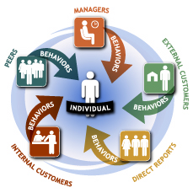
360 Degree Performance Appraisal
360 - Degree Appraisal is a system or process in which employees receive confidential, anonymous feedback from the people who work around them..

Slide 10
What are 360⁰ Measures ?
360 degree measures behaviors and competencies.
360 degree addresses skills such as listening, planning, and goal-setting.
360 degree focuses on subjective areas such as teamwork character, and leadership effectiveness.
360 degree provides feedback on how others perceive an employee.

Slide 11
360 has Four Components..
Self Appraisal
Superior’s Appraisal
Subordinate’s Appraisal
Peer Appraisal
Self appraisal gives a chance to the employee to look at his/her strengths and weaknesses, his achievements, and judge his own performance.

Slide 12
360 has Four Components..
Self Appraisal
Superior’s Appraisal
Subordinate’s Appraisal
Peer Appraisal
Superior’s appraisal forms the traditional part of the 360 degree appraisal where the employees’ responsibilities and actual performance is rated by the superior.

Slide 13
360 has Four Components..
Self Appraisal
Superior’s Appraisal
Subordinate’s Appraisal
Peer Appraisal
  Subordinates appraisal gives a chance to judge the employee on the parameters like communication and motivating abilities, superior’s ability to delegate the work, leadership qualities etc.

Slide 14
360 has Four Components
Self Appraisal
Superior’s Appraisal
Subordinate’s Appraisal
Peer Appraisal
  feedback given by peers can help to find employees’ abilities to work in a team, co-operation and sensitivity towards others.

Slide 15

720 Degree Performance Appraisal
Considered an “all-round” appraisal, the 720 degree performance appraisal gives an employee more than feedback from one person.
This appraisal gives the employee a lot of feedback generally from anywhere from 5 to 8 people, to provide the employee with an all round assessment of his or her on the job performance.

Slide 16

720 Degree Performance Appraisal
Cont..
720 degree as the name suggests is 360 degree twice
It provide for two round of feedback (a pre and post ) or a feedback approach which is done again after nine to twelve months.

Slide 17
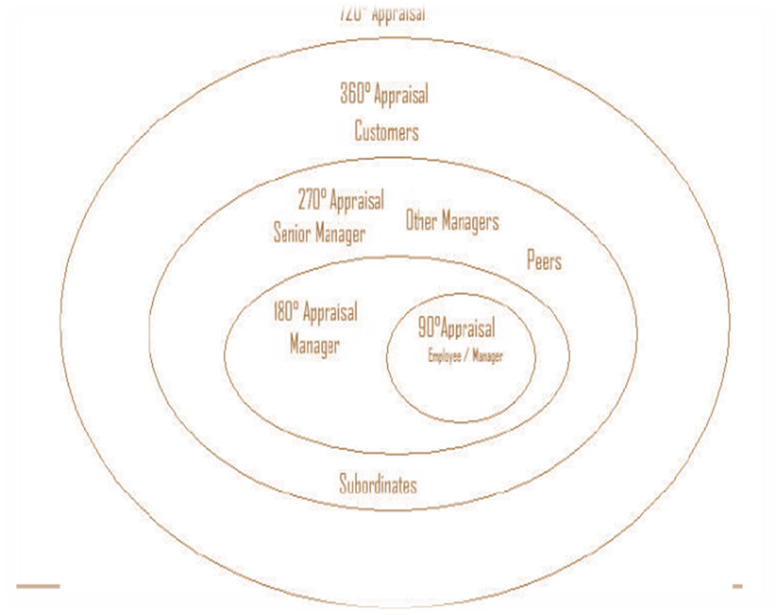

Slide 18
Needs for 720 System..
Assessment system should be 360 degrees.
Assessment should be done twice a year.
Different assessments should be tabulated and compared for a given period.
Ensure that the rating instruments are relevant, valid and reliable
Treat employees with sensitivity and respect

Slide 19
WHY USE 720….
This system is more development focused than performance alone, and supplements training and development functions in a better way
Without these critical competencies, executives and managers are less likely to be able to lead these organizations toward successful implementation of strategic changes.
A powerful developmental tool because when conducted at regular intervals it helps to keep a track of the changes, others’ perceptions about the employees

Slide 20
Advantages
Improved Feedback From More Sources
Performance Development
Responsibility for Career Development
Improved Customer Service
Training Needs Assessment

Slide 21
Disadvantage
Exceptional Expectations for the Process
Insufficient Training and Process Understanding
Focus on Negatives and Weaknesses
Rater Inexperience and Ineffectiveness
Requires commitment of top management and the Human resources (time, financial resources etc)\

Slide 22
Types of Rating Errors
Leniency/Strictness Error
    Define Anchors (Dimensions)
Central Tendency
    Reluctant to Give High/Low
    Explain Need for Variability
Recency Error
    Last Action Halo
    Encourage Frequent Evaluation

Slide 23

Error of Central Tendency
Performance-rating error in which all employees are rated about average.

Slide 24

Leniency or Strictness Error
Performance-rating error in which the appraiser tends to give employees either unusually high or unusually low ratings.

Slide 25

Recency Error
Performance-rating error in which the appraisal is based largely on the employee’s most recent behavior rather than on behavior throughout the appraisal period.

Slide 26
Rating Errors Example
Halo |  | Job Rating Scale EXCELLENT on all factors
Leniency | Job Rating Scale Employee A EXCELLENT | Job Rating Scale Employee B EXCELLENT | Job Rating Scale Employee C SUPERIOR | Job Rating Scale Employee D EXCELLENT
Central Tendency | Job Rating Scale Employee A AVERAGE | Job Rating Scale Employee B AVERAGE | Job Rating Scale Employee C AVERAGE | Job Rating Scale Employee D AVERAGE
Recency Bias |  | Job rating scale behavior during the last month has been POOR.

Slide 27

Similar-To-Me Error
Performance-rating error in which an appraiser inflates the evaluation of an employee because of a mutual personal connection.

Slide 28


